Slide 1
AUTOMATIC RAILWAY GATE CONTROL SYSTEM USING VIBRATION SENSOR
BY,
NAGARAJ .V

Slide 2
1. INTRODUCTION:
Railway crossings are accident-prone areas
Manual gate operation may cause delay or human error
This project uses a vibration sensor to detect train movement
Sensor is placed 2 km before the railway gate
When train is detected, the gate closes automatically
This system improves safety and automation

Slide 3
3 . ABSTRACT:
The project detects a train 2 km before the gate
It uses a vibration sensor on the railway track
Train movement creates vibration on the track
Sensor sends signal to the microcontroller
Opposite gate closes first
After 2 minutes, the main gate closes
Speaker gives warning alert
After train passes, gates open automatically

Slide 4
4 . OBJECTIVE:
To detect train before reaching the railway gate
To close the gate automatically
To reduce railway crossing accidents
To provide early warning using speaker alert
To reduce manual work and human error
To improve safety in unmanned crossings

Slide 5
5 . MATERIALS REQUIRED:
Hardware:
Software:
Vibration Sensor
Arduino UNO / ESP32
Servo Motor / DC Motor
Motor Driver Module
Speaker / Buzzer
IR Sensor / Exit Sensor
Relay Module
Power Supply
Connecting Wires
Gate Model
Arduino IDE
Embedded C
PowerPoint

Slide 6
6 .WORKING PRINCIPLE:
Vibration sensor monitors railway track
Train creates vibration on the track
Sensor detects vibration at 2 km before gate
Signal is sent to the microcontroller
Speaker alert turns ON
Opposite gate closes first
After 2 minutes, main gate closes
After train passes, gates open automatically

Slide 7
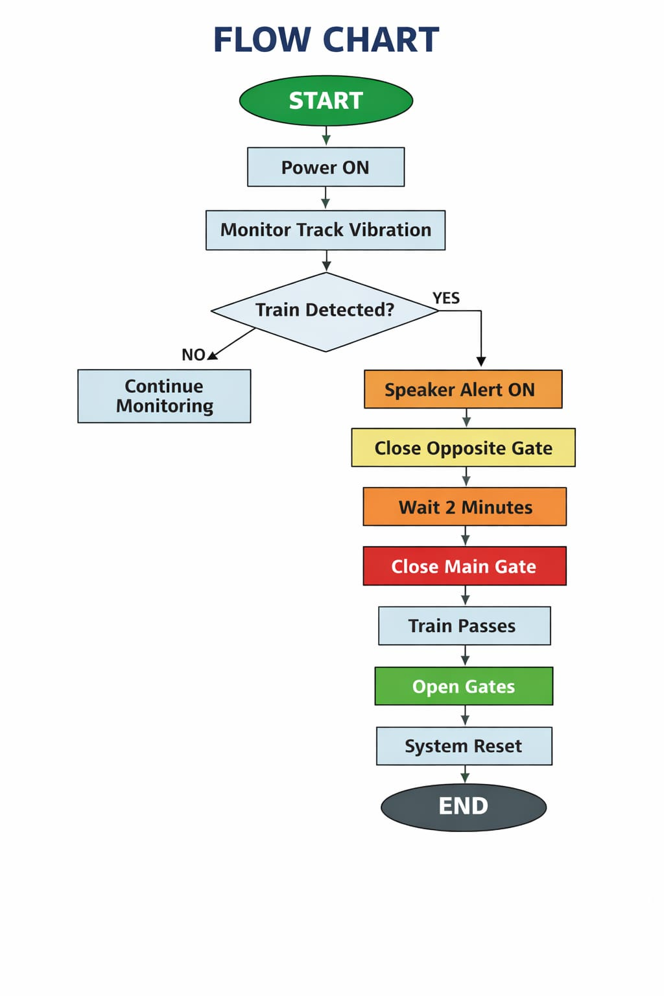
7.FLOW CHART:

Slide 8
8.COMPARISON:
Manual System | Automatic System
Manual operation | Automatic operation
More human error | Less human error
Delay possible | Fast response
Less safety | More safety
No early warning | Early warning available
Not suitable for unmanned areas | Suitable for unmanned areas

Slide 9
9.ADVANTAGES:
Unmanned railway crossings
Rural railway gate areas
Smart railway automation systems
Industrial railway crossings
Railway station entry/exit control
Public safety monitoring systems

Slide 10
10.CONCLUSION:
Automatic gate control
Reduces human error
Prevents railway crossing accidents
Early train detection
Speaker alert for public safety
Suitable for unmanned crossings
Low cost and easy to implement

